Slide 1
Use Case 1: Predict Customer Success
Olivia Larrea
Apurva Shetty
Niha Garikapati
Notes:
"Good evening, everyone. It’s our pleasure to be here today to present our final capstone project on Swire Coca-cola’s Use case 1: Predicting Customer success. My name is Niha, this is Apurva and Olivia. And together we would be sharing an overview of our project.

Slide 2
Overview of the Presentation
Objectives
Methodology
Model Selection
Deployment and Evaluation
Final Recommendation
Future Steps
Notes:
We begin the overview of our presentation with a brief objective of what we are trying to solve followed by the approach we used to do the same.
Next, comes the different models we fit based on the project needs.
Followed by implementing the model along with accessing their performance for Final Recommendations and Future steps.

Slide 3
Overview of the Presentation
Objectives
Methodology
Model Selection
Deployment and Evaluation
Final Recommendation
Future Steps
Notes:
We begin the overview of our presentation with a brief objective of what we are trying to solve followed by the approach we used to do the same.
Next, comes the different models we fit based on the project needs.
Followed by implementing the model along with accessing their performance for Final Recommendations and Future steps.

Slide 4


Discounts
Notes:
As we know 10% of of Swire’s business is “B2B”. So whenever there is a new business in the market Swire would need to win it over by giving discounts.
So we started wondering what Swire actually needs to be successful. Understanding the challenge here is to predict the success of new businesses launched in the market.

Slide 5



Key Factors of Success
Customer relations/communications
Operational excellence
Financial management
Notes:
As a general idea of a successful business there are broadly 3 key factors namely –
Operational excellence
Customer relations/communications
Financial management
Success of which can be predicted through either Longevity, Popularity or Sales Volume.

Slide 6
Overview of the Presentation
Objectives
Methodology
Model Selection
Deployment and Evaluation
Final Recommendation
Future Steps
Notes:
We begin the overview of our presentation with a brief objective of what we are trying to solve followed by the approach we used to do the same.
Next, comes the different models we fit based on the project needs.
Followed by implementing the model along with accessing their performance for Final Recommendations and Future steps.

Slide 7
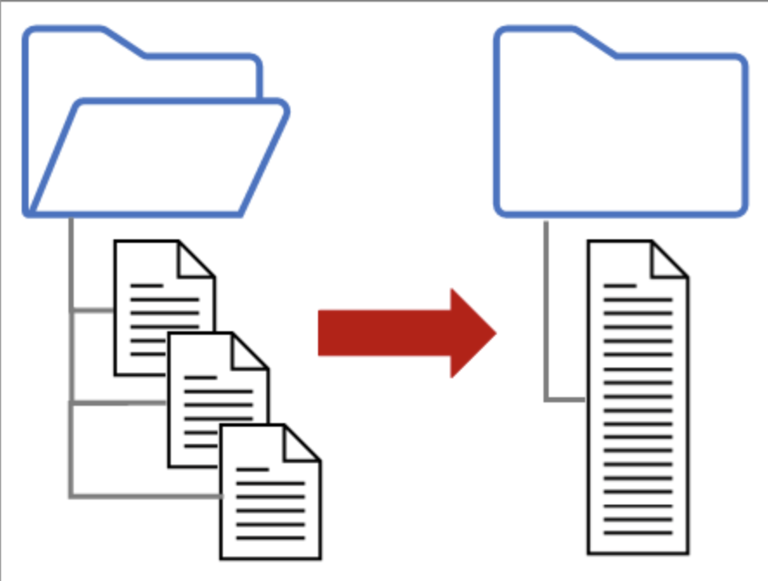

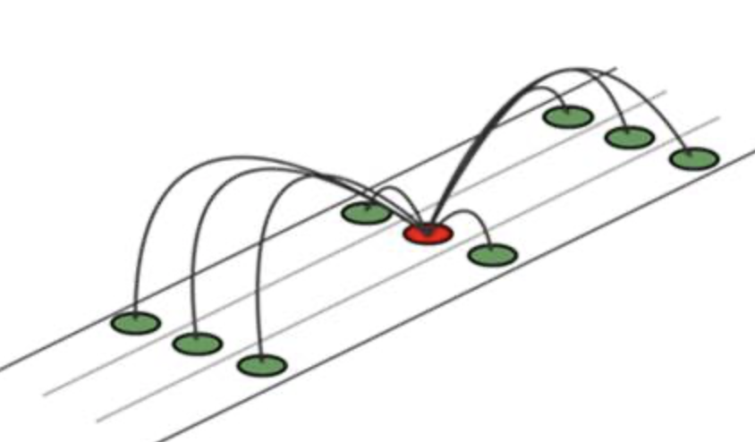
Data Pre-processing
Merging
Cleaning
Imputation
Notes:
We pre-processed the data by first merging the Customer and Sales data to give us a unified Customer – Product dataset which is on the product-level.
We later combined the demographic information which we got from the public platform. This we achieved by separating the Address zip code column which contained the ZIP code + FIPS code at a product-level. So in simple words what Address zip code column contains is information a specific location along with information of a specific region in that location. So, as we wanted to combine location wise information we split the Address zip code into two different columns Address code and Zip code and merged the population and density information Zip code wise .
On further inspection we found few discrepancies in columns such as ON_BOARDING_DATE which had obvious error.
We used the median/mode method for imputing missing values.
Other steps in pre-processing were to drop few columns such as Address code, state_id and state_name due to low variance.

Slide 8


Data Preparation
Sales Volume
Longevity
Notes:
This step onwards we actually combine the individual efforts of our team to better answer the business problem of predicting the overall success. We split our efforts of prepping and modelling for the two metrics Sales Volume and Longevity.

Slide 9
Sales Volume

Slide 10
Data Dictionary
Package type description
Physical Volume
Beverage Category
Calorie category
Discount
Cost of the product

Slide 11
Data Preparation
Grouping Data
Cost of the Product
Discount Offered

Slide 12
Overview of the Presentation
Objectives
Methodology
Model Selection
Deployment and Evaluation
Final Recommendation
Future Steps
Notes:
We begin the overview of our presentation with a brief objective of what we are trying to solve followed by the approach we used to do the same.
Next, comes the different models we fit based on the project needs.
Followed by implementing the model along with accessing their performance for Final Recommendations and Future steps.

Slide 13
Model Selection
Linear Regression
Regularized Linear Regression
Decision Trees
Random Forest

Slide 14
Overview of the Presentation
Objectives
Methodology
Model Selection
Deployment and Evaluation
Final Recommendation
Future Steps
Notes:
We begin the overview of our presentation with a brief objective of what we are trying to solve followed by the approach we used to do the same.
Next, comes the different models we fit based on the project needs.
Followed by implementing the model along with accessing their performance for Final Recommendations and Future steps.

Slide 15
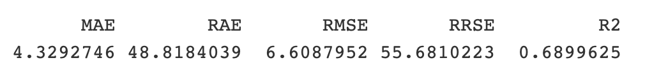
Linear Regression

Slide 16
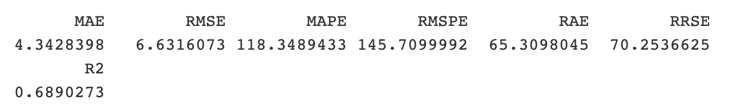
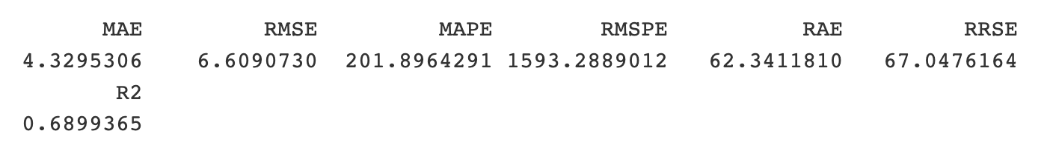
Regularized Linear Regression
Ridge
Lasso

Slide 17
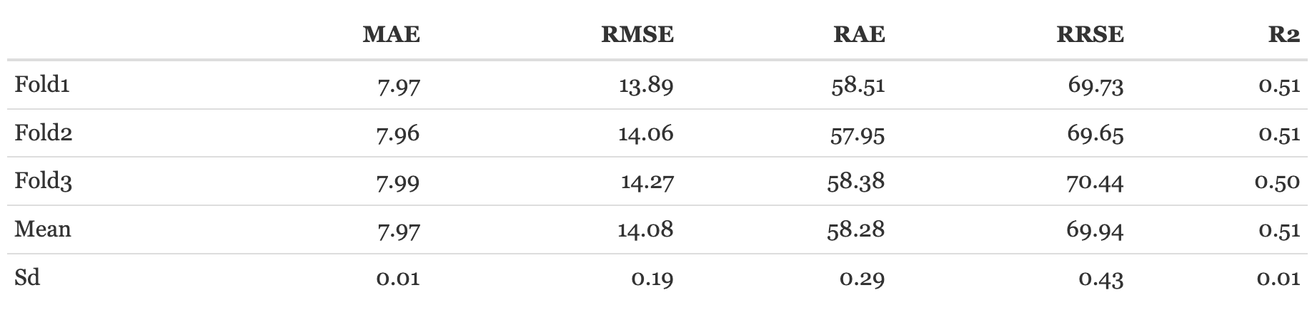
Decision Tree
Without Tuning
Cross Validation with Tuning

Slide 18
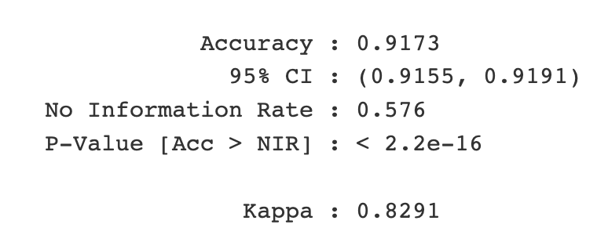
Random Forest

Slide 19
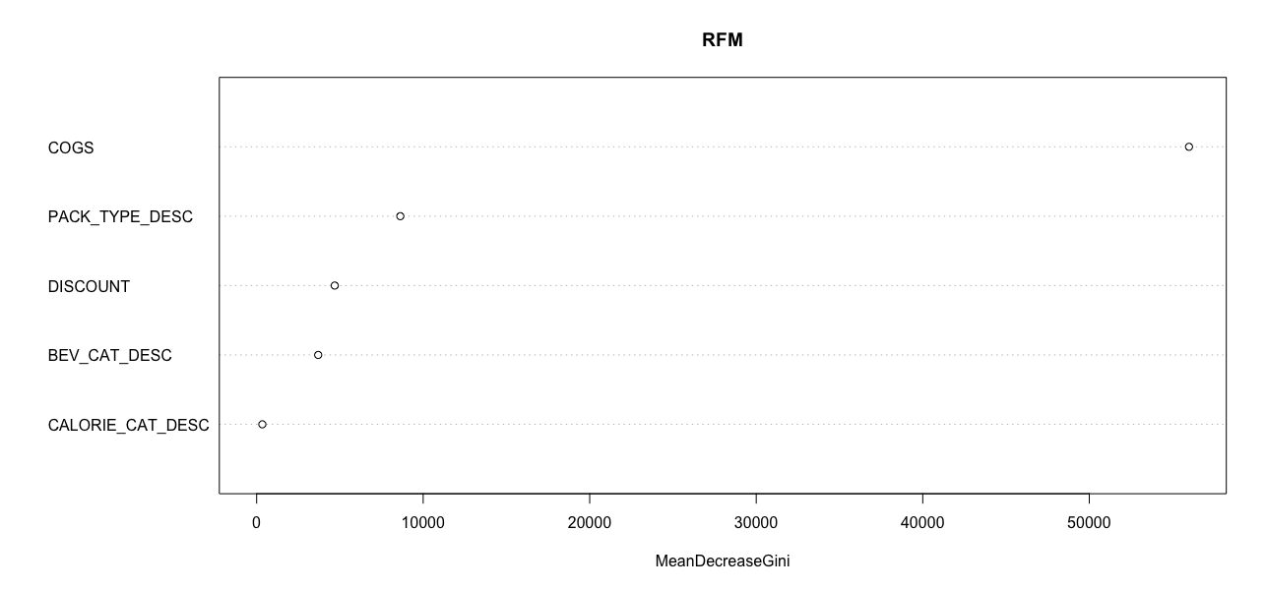
Summary: Factors affecting Sales Volume

Slide 20
Longevity

Slide 21
Data Dictionary
Demographics
Number of Transactions
Physical Volume
Sales Office Description
Activity Cluster
Trade Channel

Slide 22
Data Preparation
Grouping Data
Longevity

Slide 23
Overview of the Presentation
Objectives
Methodology
Model Selection
Deployment and Evaluation
Final Recommendation
Future Steps
Notes:
We begin the overview of our presentation with a brief objective of what we are trying to solve followed by the approach we used to do the same.
Next, comes the different models we fit based on the project needs.
Followed by implementing the model along with accessing their performance for Final Recommendations and Future steps.

Slide 24
Model Selection
Linear Regression
Regularized Linear Regression
Decision Trees

Slide 25
Overview of the Presentation
Objectives
Methodology
Model Selection
Deployment and Evaluation
Final Recommendation
Future Steps
Notes:
We begin the overview of our presentation with a brief objective of what we are trying to solve followed by the approach we used to do the same.
Next, comes the different models we fit based on the project needs.
Followed by implementing the model along with accessing their performance for Final Recommendations and Future steps.

Slide 26
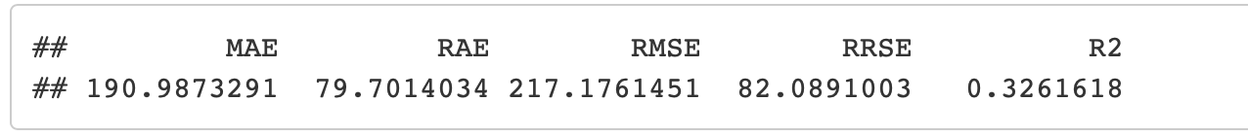
Linear Regression

Slide 27
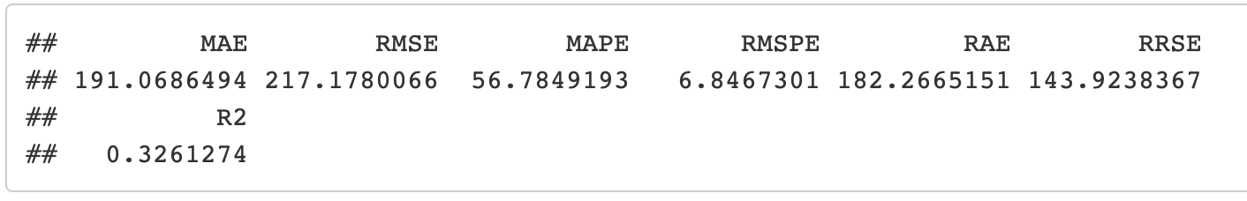
Regularized Linear Regression
Ridge
Lasso

Slide 28
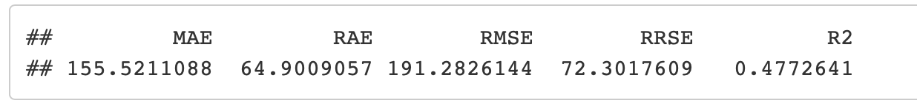
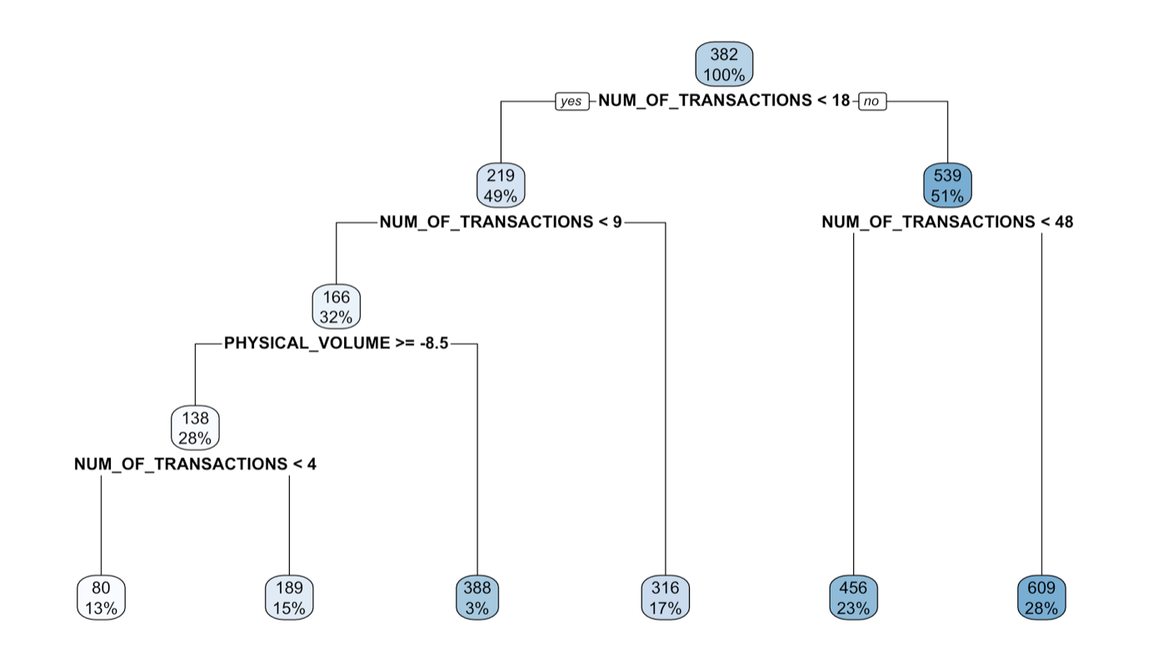
Decision Trees

Slide 29
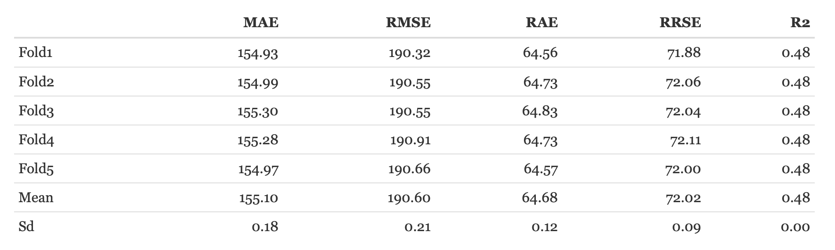
Tuned Decision Trees

Slide 30
Summary: Factors affecting Longevity
Number of Transactions
Physical Volume
Customer Trade Channel

Slide 31
Executive Summary
Estimating long lasting business
Pricing product categories
Discounts on product categories

Slide 32
Overview of the Presentation
Objectives
Methodology
Model Selection
Deployment and Evaluation
Final Recommendation
Future Steps
Notes:
We begin the overview of our presentation with a brief objective of what we are trying to solve followed by the approach we used to do the same.
Next, comes the different models we fit based on the project needs.
Followed by implementing the model along with accessing their performance for Final Recommendations and Future steps.

Slide 33
Final Recommendations
Combining the effecting factors
Modeling with weightage
Modeling as a qualifier

Slide 34
Overview of the Presentation
Objectives
Methodology
Model Selection
Deployment and Evaluation
Final Recommendation
Future Steps
Notes:
We begin the overview of our presentation with a brief objective of what we are trying to solve followed by the approach we used to do the same.
Next, comes the different models we fit based on the project needs.
Followed by implementing the model along with accessing their performance for Final Recommendations and Future steps.

Slide 35
Future Steps
Adding Popularity
Customize discounts based on Trade channel
In depth analysis on Pack Type description

Slide 36
Any Questions?
Notes:
1. How are we going to share the git – we need emails to give everyone access.
2. Is the overview covering everything, do you think we missed anything.
3. Is font ok?
4. Do we follow the same format for documentation, is there a limit on how much we should add in the doc.
5. Do we have to mention individual contributions in the doc. Sample documents
6. Do we include code in the doc
7. Are the pictures in the slides fine
8. Do you think we followed the presentation guideline

